Slide 1
Logistic Regression Analysis
Zihan Yan

Slide 2
Overall
This analysis applies a Logistic Regression model on an admissions dataset.
Features: GPA, GMAT
Target: Admission Decision

Slide 3
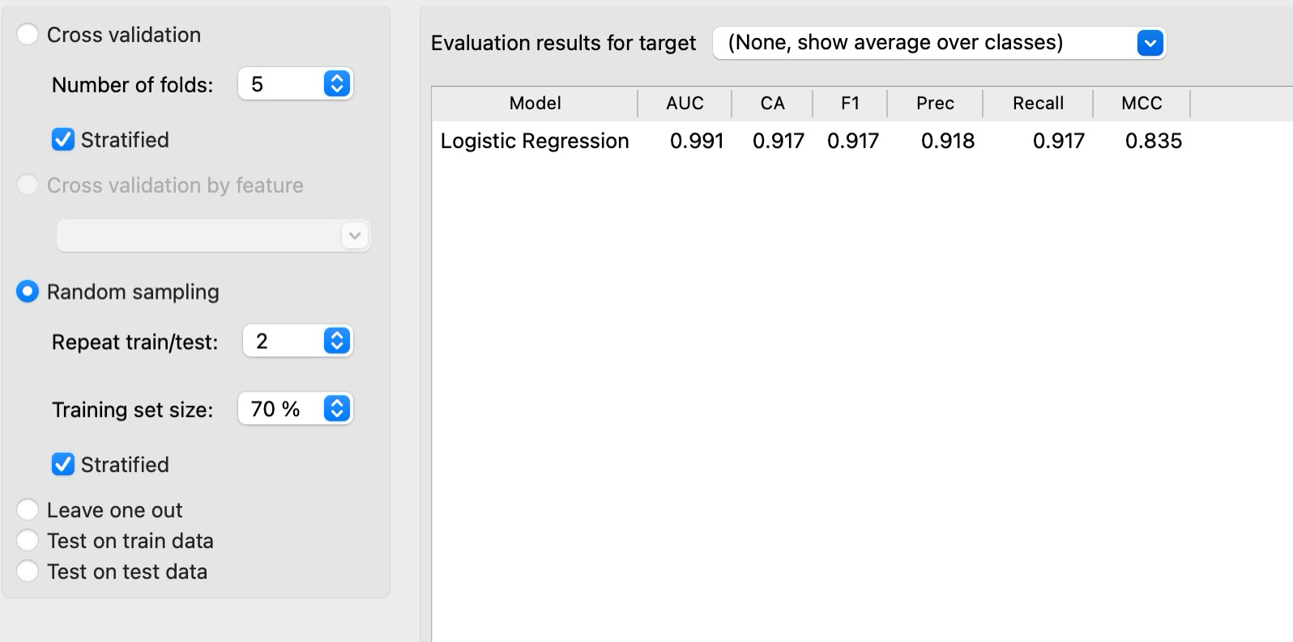

Slide 4


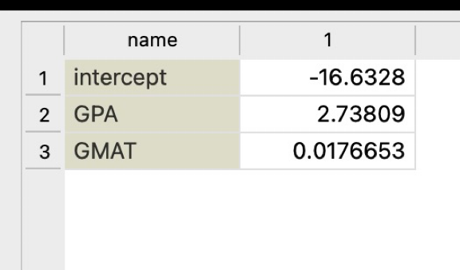
Data Splitting and Logistic Regression Model
The intercept and coefficients obtained from the model:
Intercept -16.63
Coefficient for GPA 2.74
Coefficient for GMAT 0.018

Slide 5
Conclusion.
GPA is more significant in determining admission decision.

